Slide 1

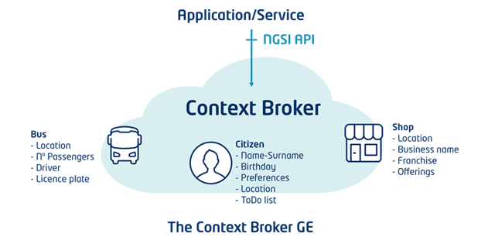
fiware-publisher
(Java process or Docker container)
HTTP/REST calls to subscribe to Context Broker changes
Azure Event Hubs SDK
Mgmt end-point
Notification endpoint
Azure Event Hub
Subscription requests
Change notifications

